Slide 1
Basics of information searching
Bruce Pencek
College Librarian for Social Science & History
University Libraries at Virginia Tech (lib.vt.edu)
bpencek@vt.edu
Summer2018

Slide 2
The facts of (re)search life
There’s no reason to assume data or literature exist on your research question simply because you want it to. You’ll have to find parts of other literatures/data and assemble them yourself, often reasoning by analogy.

Slide 3
Today’s agenda
First principles: the kinship of research and lit-search
The VT Libraries website: key points
Finding data:
Bottom up from journalism (place-based)
Top down from data collections (concept-based)
Finding scholarly articles
In resources organized around problems/controversies
In resources organized around disciplines

Slide 4
Literature- and data-search support research
Lit searching seeks to find
What previous published knowledge (“the literature”) says about answering your research question (or some part of it)
About how researchers have tried to answer questions like yours (theories and methodologies)
About existing answers (data, findings, and conclusions)
About patterns and documentation (literature reviews and bibliography)
What evidence exists to support / modify / refute alleged answers
Extract pieces of the literature
About aspects/parts of your research question (eg, works that use one of your variables)
Similar or analogous to your research question (eg, same issue in another place)
Don’t expect literature or data to provide straight yes/no, “right”/”wrong” answers to interesting research questions.

Slide 5
Literature- (and data-) searching is inquiry
At its simplest, lit searching is the systematic solving of puzzles or problems about existing knowledge
Through processes of
Turning research questions into manageable, focused search strategies relating to the concepts in your research design
Making hunches about where – and if – information exists to answer some part of your research question
Figuring out how most efficiently to get needed information
Deciding what counts as relevant information to your specific research question
Revising and refining search terms, techniques, and tools in light of search results
Applying what you learned in searching in one setting to searching in others
Documenting information sources so others can use or challenge your research
It isn’t simply foraging for tasty morsels.
It isn’t simply summarizing, as if all sources were equally worthwhile.

Slide 6
Start by taking stock
What kind(s) of information/data do you need to answer your question?
What sorts of people or entities have a stake in gathering information on your topic?
Why and how would they gather information?
What would they call it?
(In group work: plan, reach group agreement about your research question, approach an needs before assigning tasks to member)

Slide 7
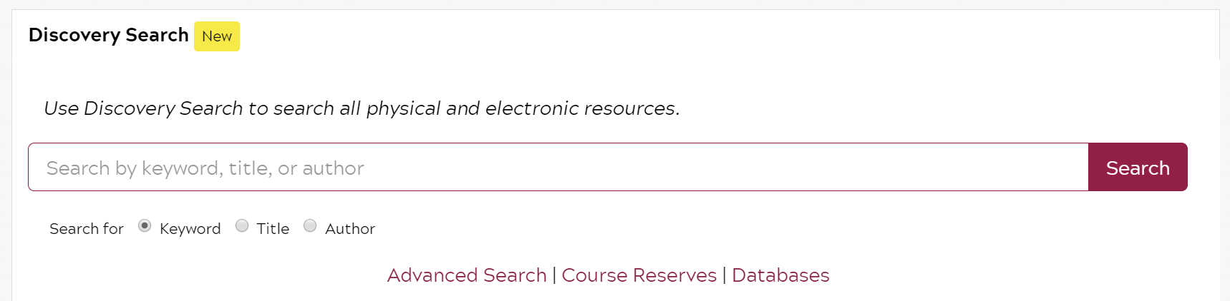
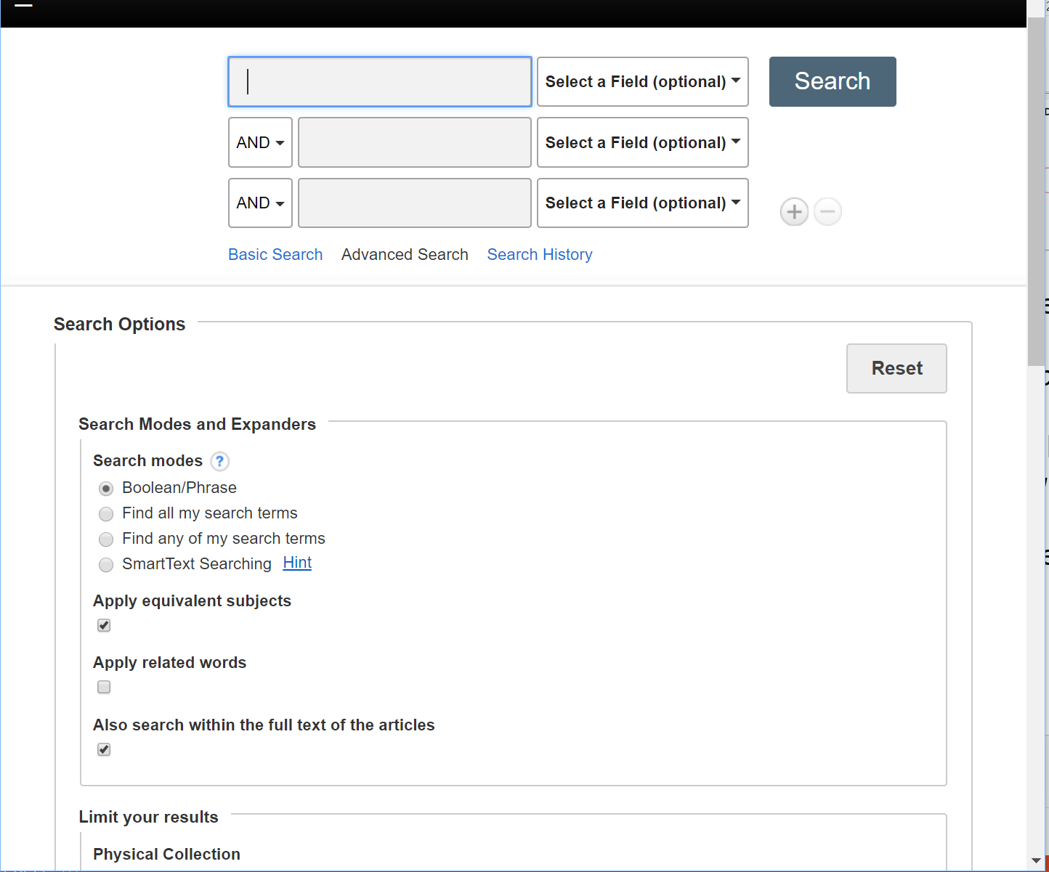
Search tools
Our ‘discovery search’ [EDS]system:
~90% of stuff we have e-records of
Bibliographic records – whether we
have those document or not
Ejournal articles
Ebooks and print books
Doesn’t know much about datasets
EDS is useful for (only) 3 things
Known item search/retrieval
Scanning information environment
(aka ‘presearch’)
Mopping up outlying literature when
you begin writing your first draft

Slide 8

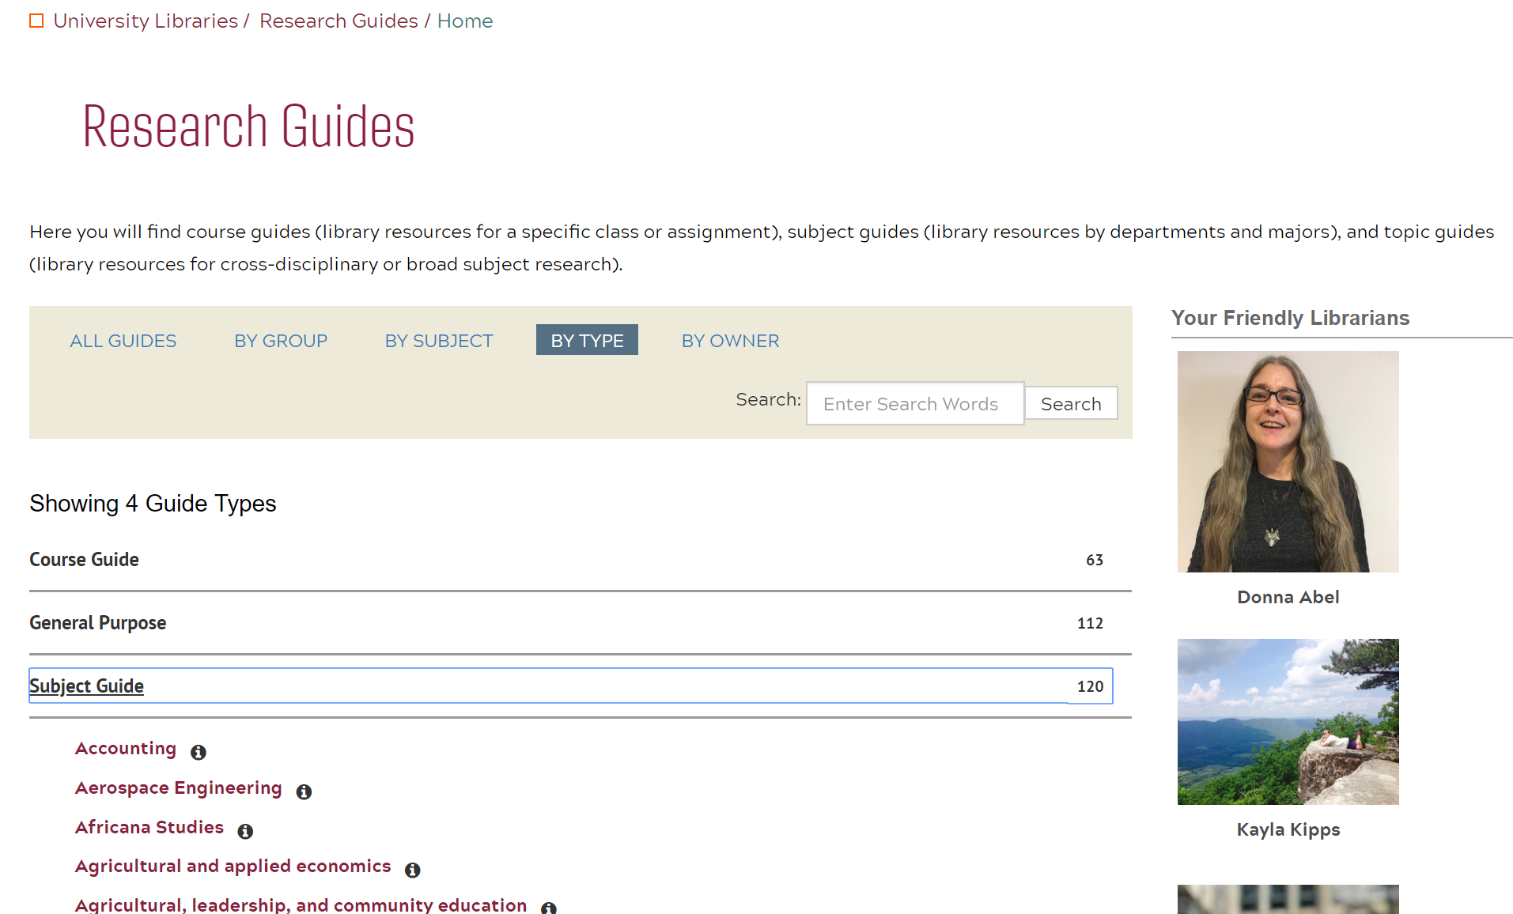
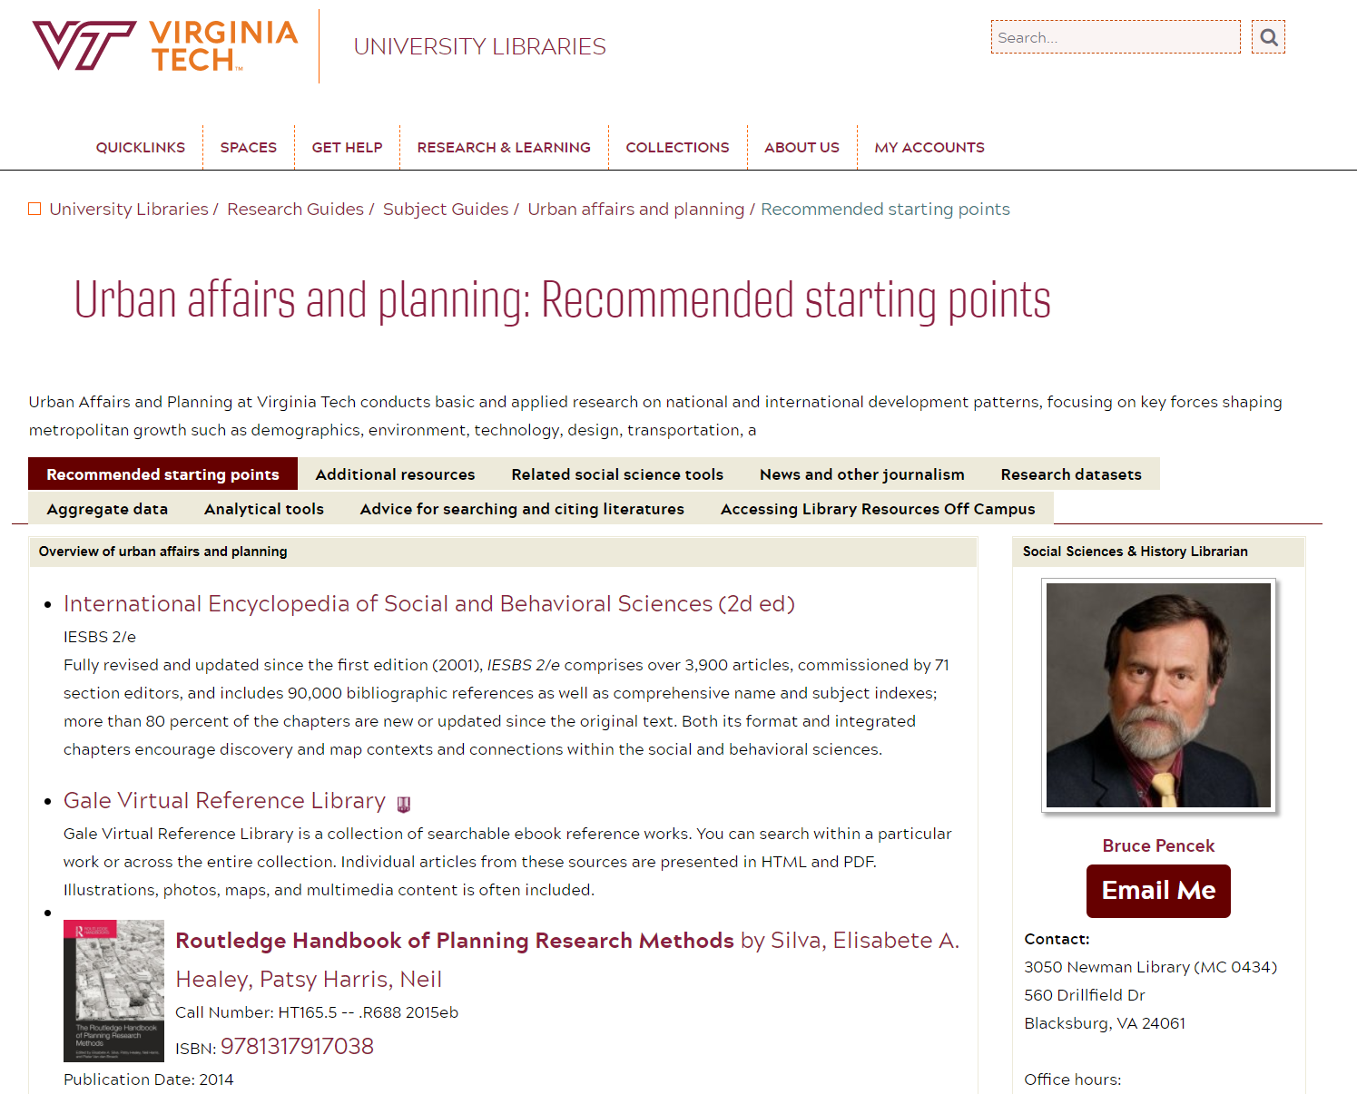
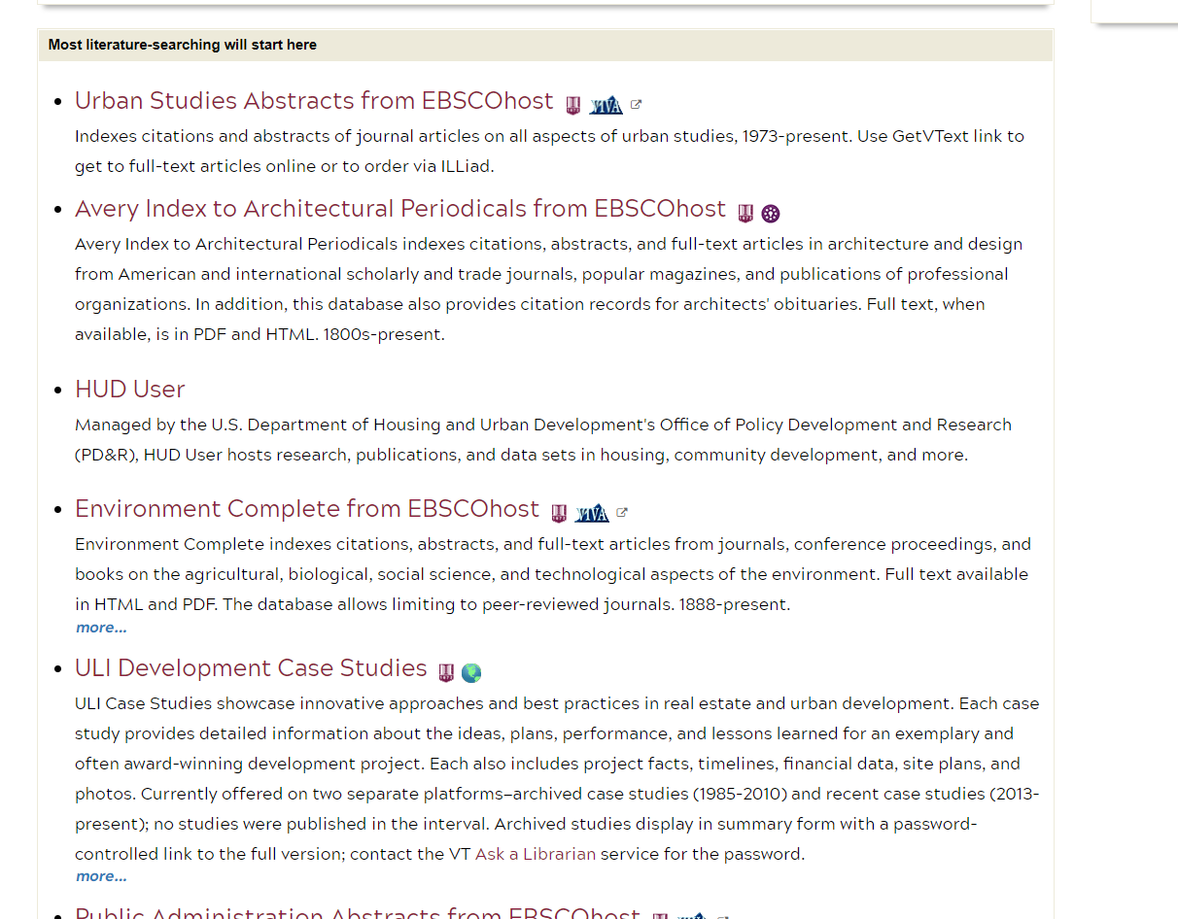
Your handy research toolkit:
Subject guides
subject databases
Use to find scholarly or professional articles
Authoritative, quality background info
Notes:
Bookmark these: Subject guides A-Z: <https://guides.lib.vt.edu/subject-guides> Databases A-Z: <https://guides.lib.vt.edu/az.php>

Slide 9
DATA: If you’re interested in places with problems
Start with local journalism to get a handle on local problems – so you learn what to look for, where in more authoritative, rigorous sources
Access World News database is pretty simple, but covers newspapers across the US (even small cities like Roanoke) and much of the globe. (Factiva is bigger, in the US and internationally, and more powerful, but a little harder to learn.)
Search for locations (eg, “Radford army ammunition plant” – in quotes)
Search for hazards (eg, pollutant* or toxin* or hazard*)
Interpret articles (and harvest further search terms that may appear in scholarly articles or in tables of numerical data)
What kinds of data are reported?
Who gathered them (so you can go to the agency)?
For what purpose did they gather and report those data?
What people or institutions are names as experts (so you can see what scholarship they’ve done on the topic)?

Slide 10
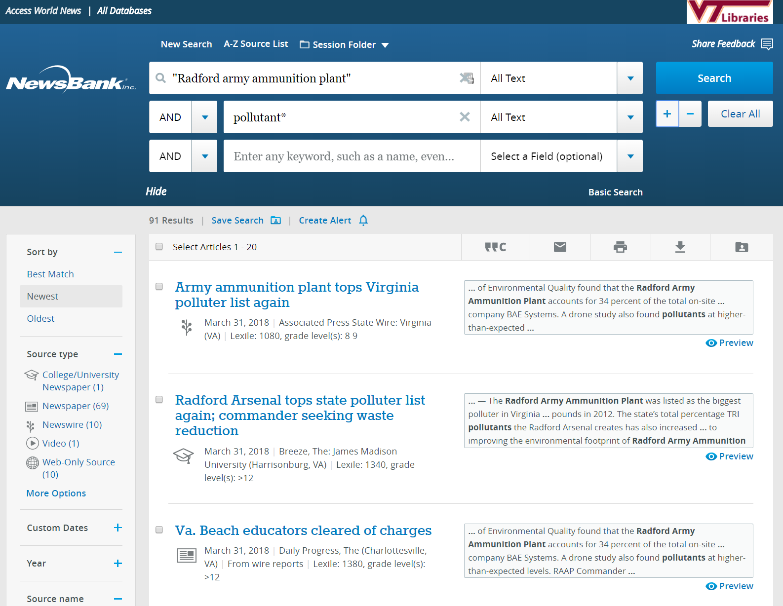
Access World News
(new interface)

Slide 11
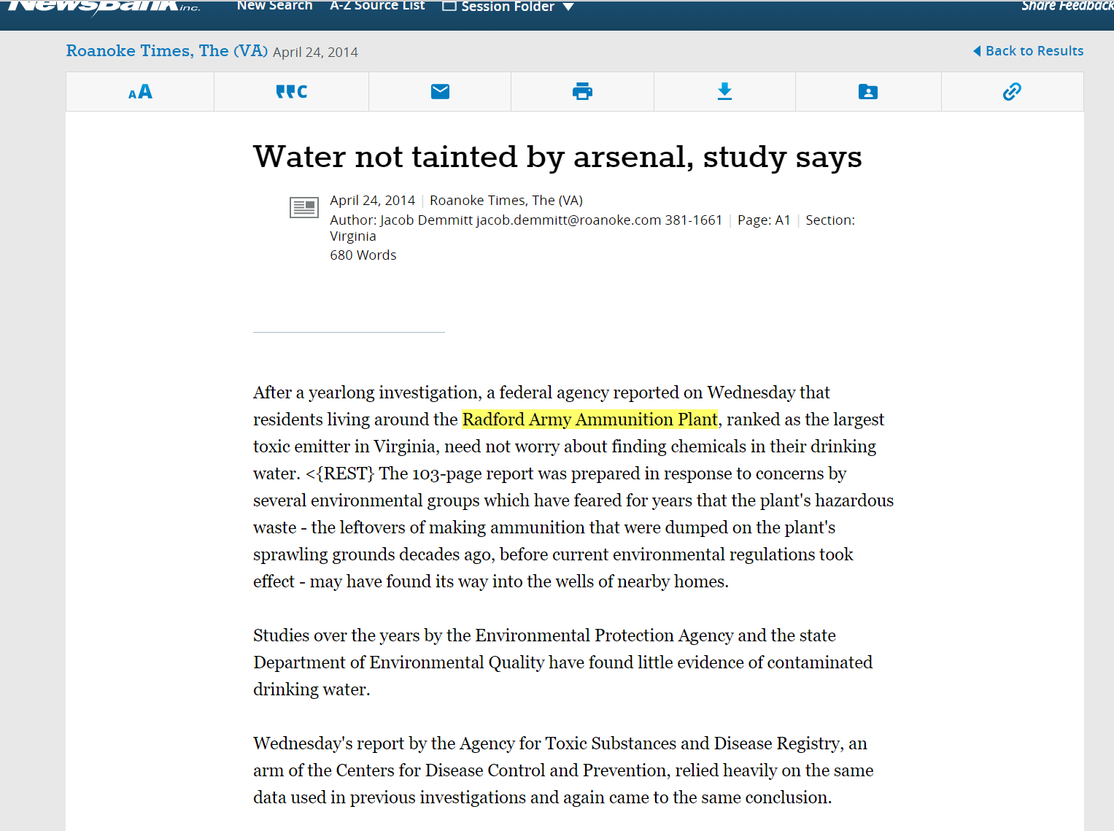
What new search terms would you harvest?
Access World News
(new interface)

Slide 12
DATA: If you’re interested in problems in general
Start in a data compilation, pick a topic, browse, and hope for data
Compilations of aggregate (tabular) government data: eg, RAND State Stats; ProQuest Statistical Insight; data.gov
Go to individual agencies, especially regulators, for data they collected
Eg, US Environmental Protection Agency; US Centers for Disease Control; Virginia Department of Environmental Quality
Split the difference: start in a geographical information system:
Eg, PolicyMap (one of the library’s cloud-based GIS services); ArcGIS Online (free via a VT site license: powerful but has a relatively steep learning curve)

Slide 13
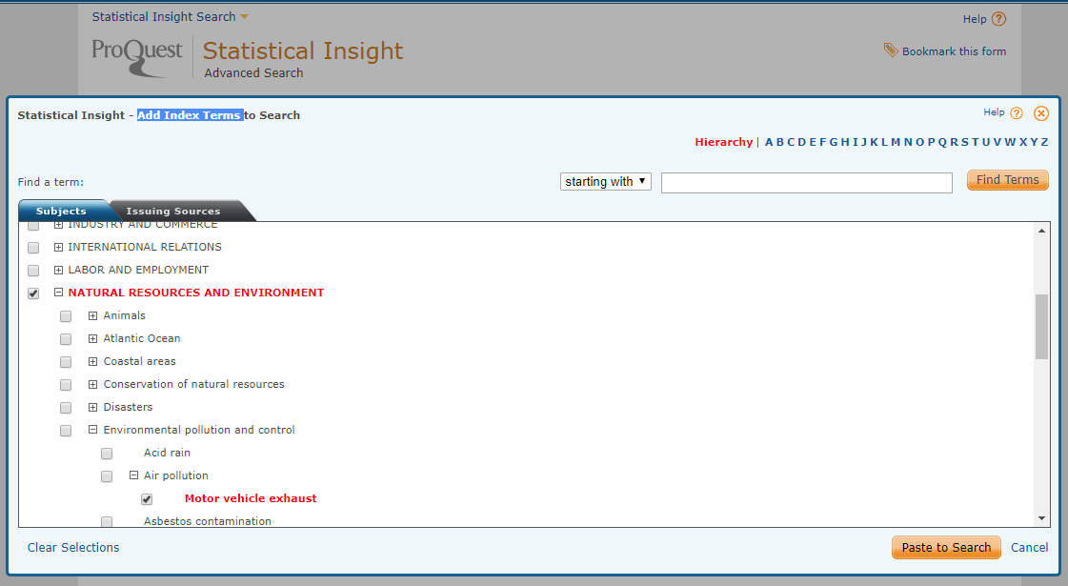
Compilations are usually easier to start in
Notes:
Statistical Insight is going away because of low usage. We’re looking at other big compilations.

Slide 14
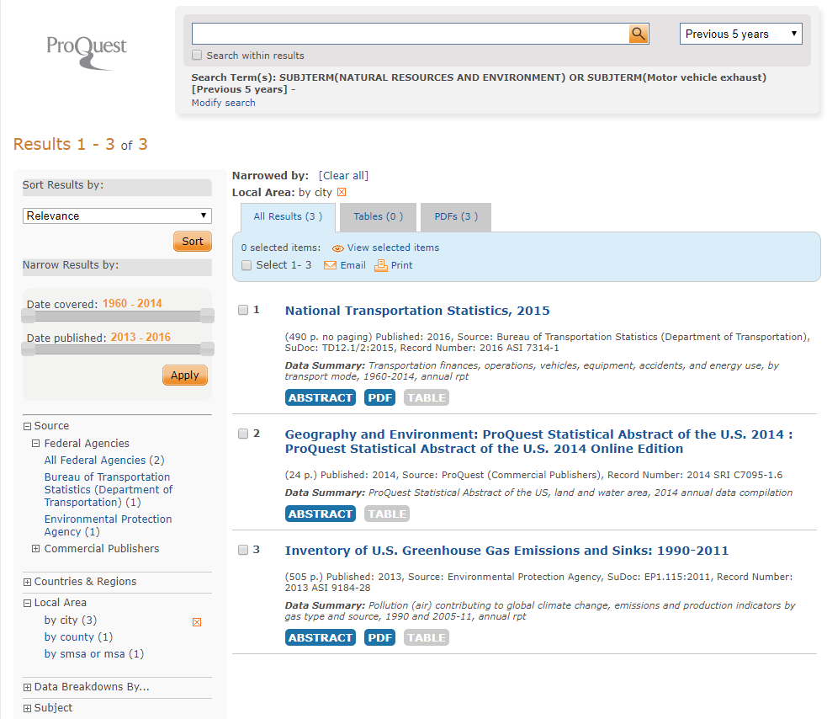
I didn’t type a word to get these reports
Statistical Insight (going away)

Slide 15
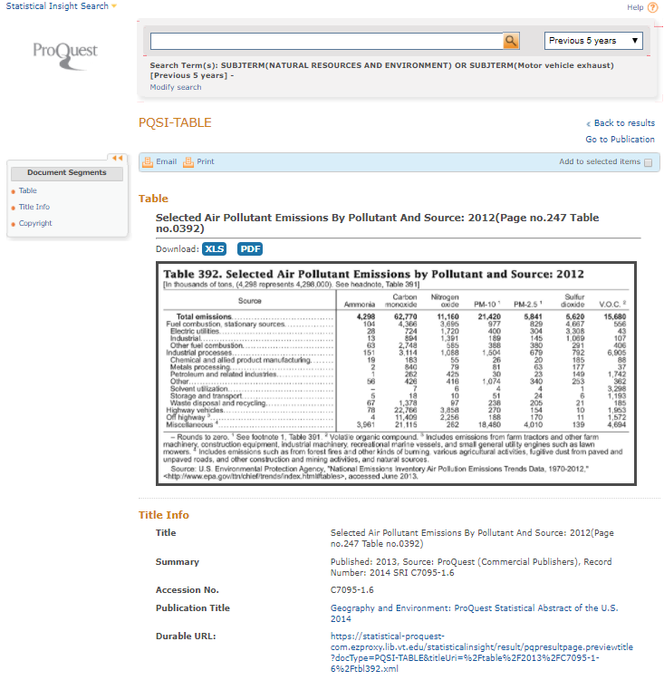
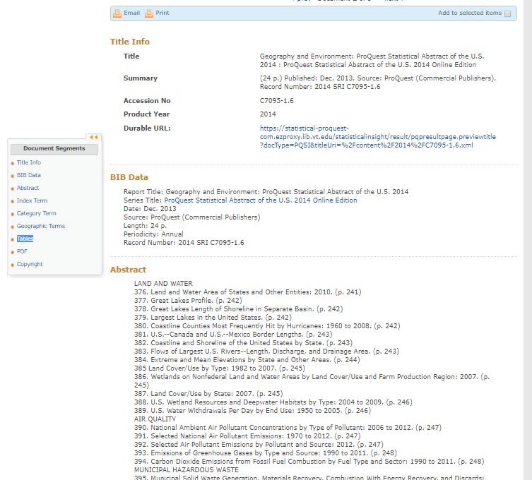
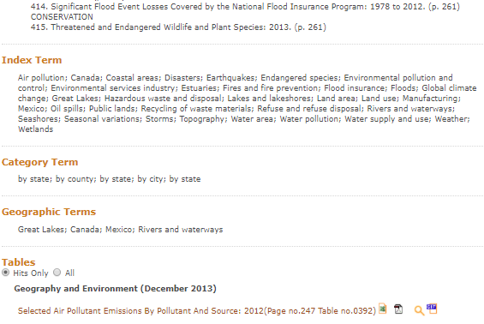
…which led here
Statistical Insight (going away)

Slide 16
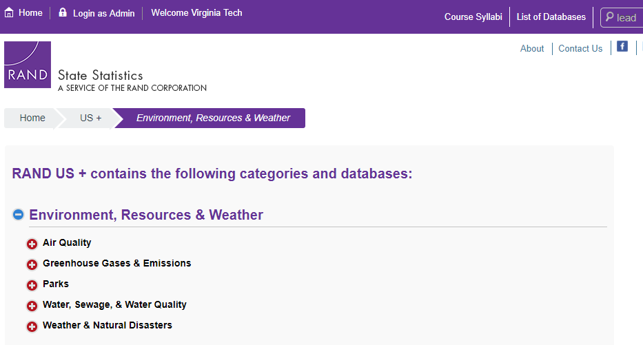
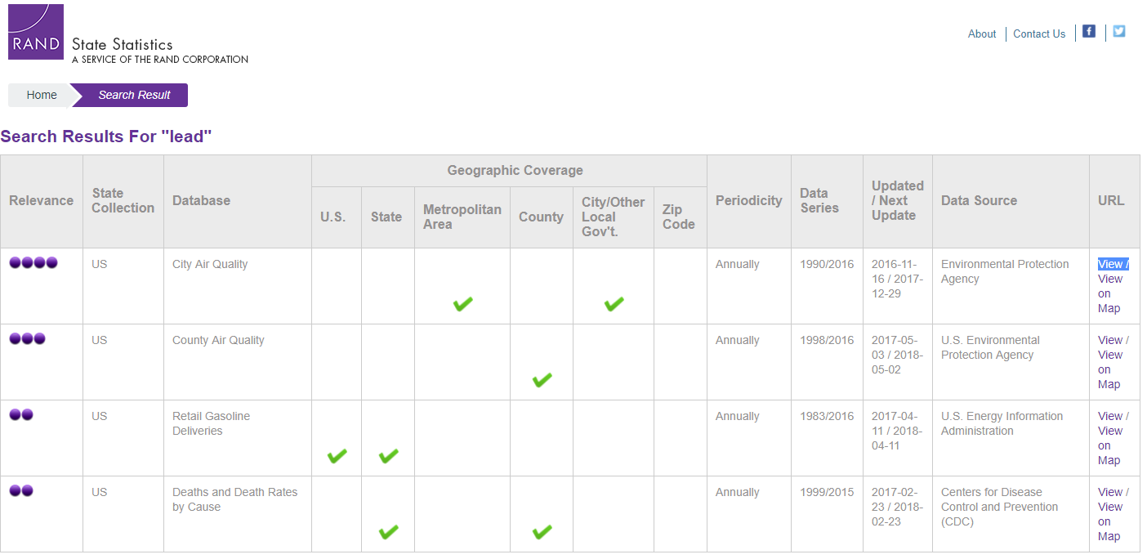
Searching by hazard
RAND State Statistics

Slide 17
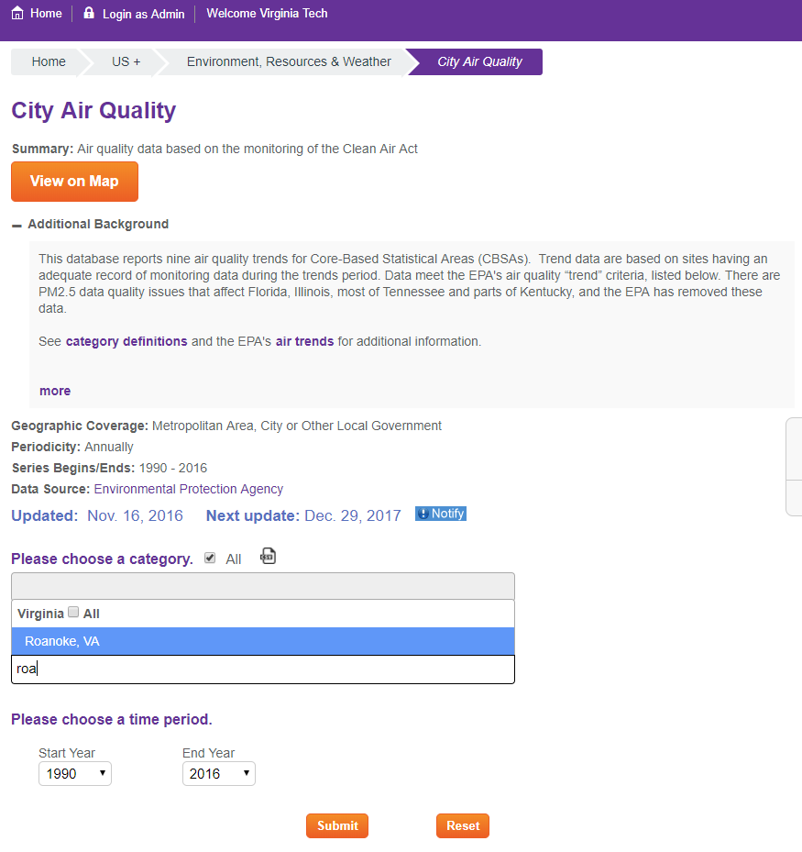
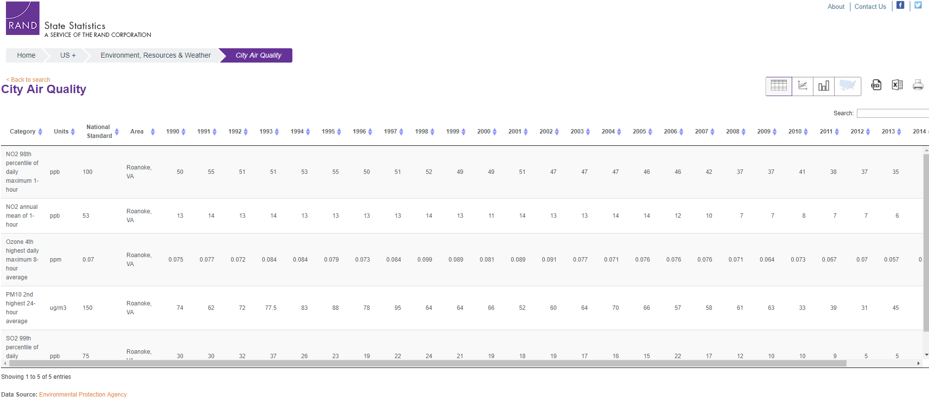
RAND State Statistics

Slide 18
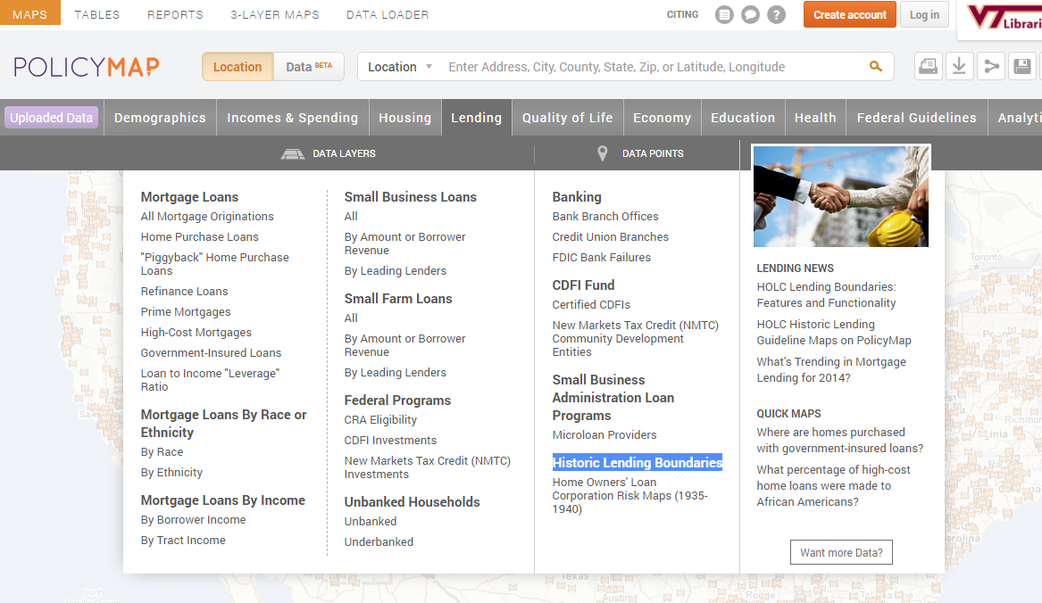
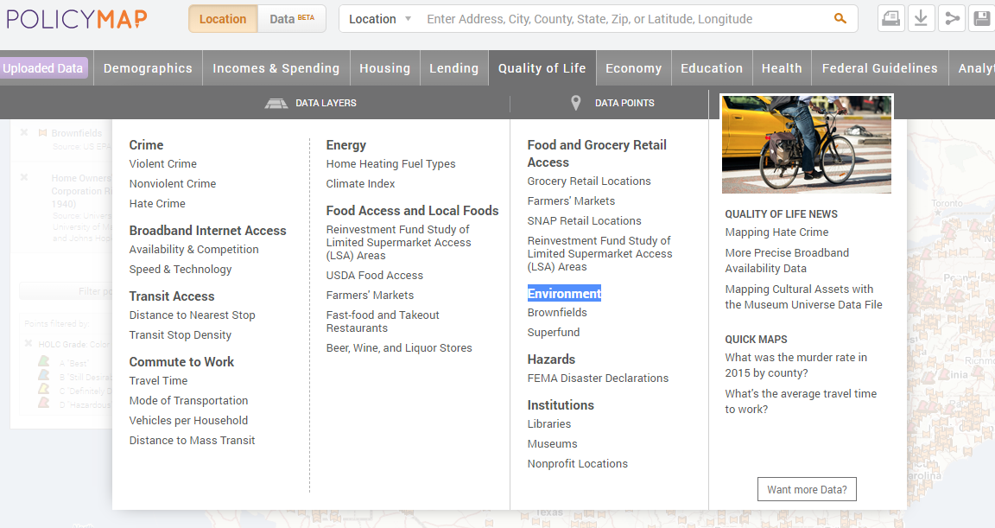
Layer data into a map
PolicyMap
(You can usually also export attribute data from a GIS into a table)

Slide 19
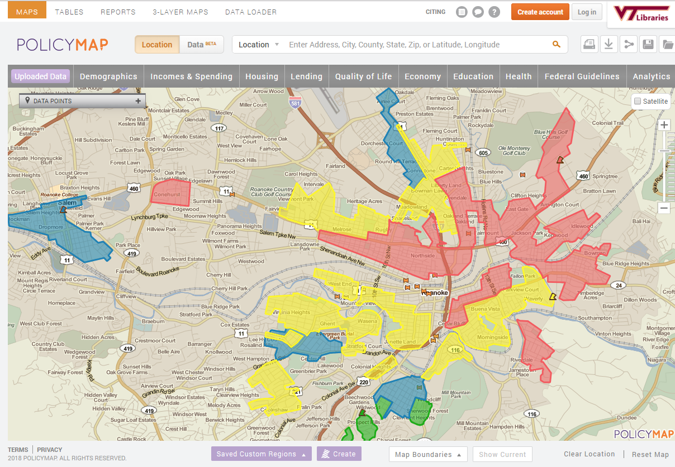
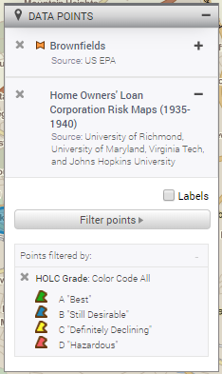
Experiment: environmental legacy of policy?
See maps in “How redlining segregated Philadelphia” (2018): https://nextcity.org/features/view/redlining-race-philadelphia-segregation)

Slide 20
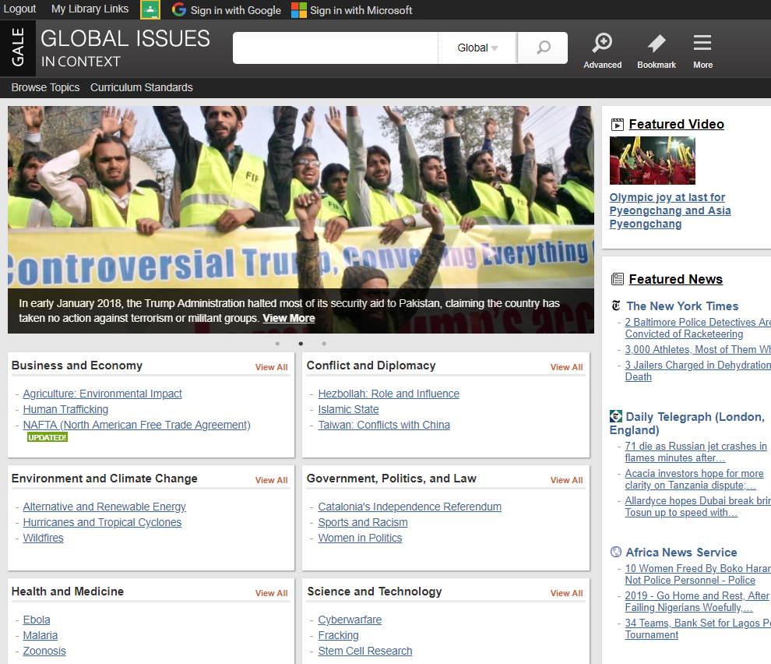
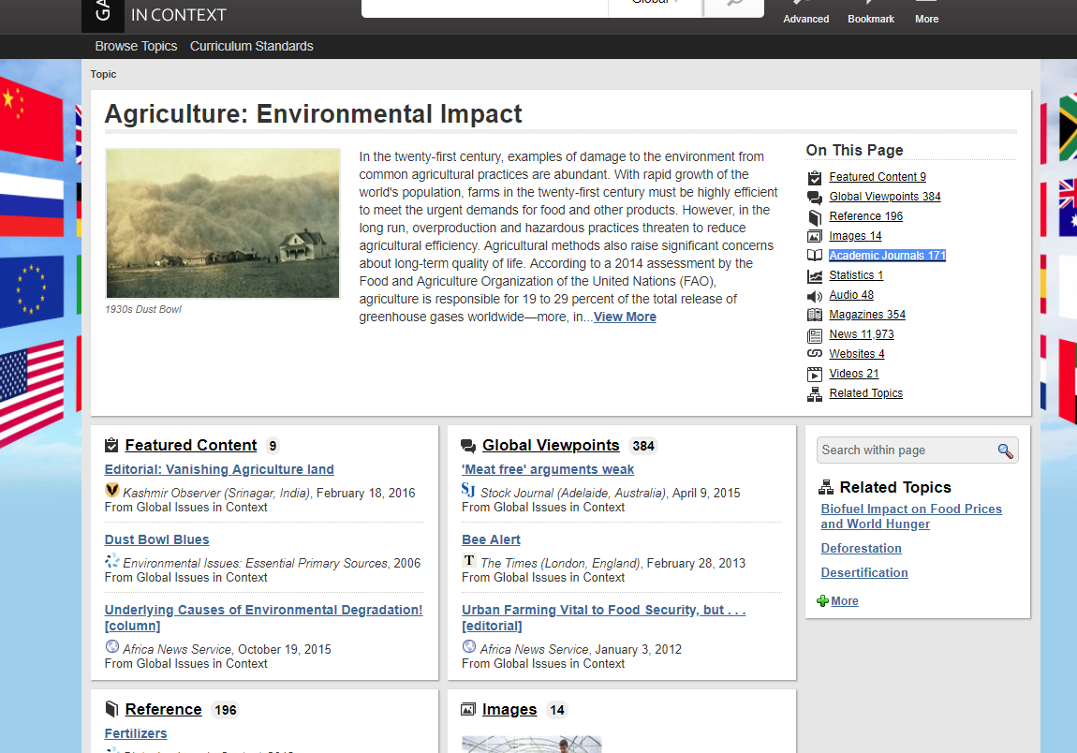
LIT SEARCH: thematic collections pull together lots of stuff
Use to frame your research for your audience, not to replace your own work
Global Issues in Context

Slide 21
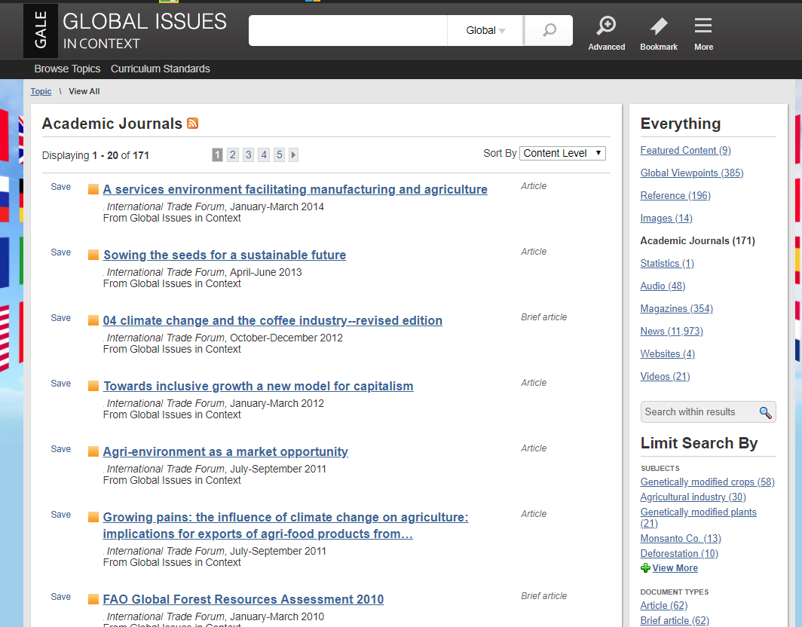
Think of them as merely starters – so you can harvest more precise search terms, including author names, technical terms, citations…

Slide 22
REAL LIT SEARCH starts in subject databases
Many times, most of your searching, especially for academic journal articles, should be in “abstracting and indexing” databases
Searching bibliographic records, not full text.
Abstracts can be gold mines, bridging technical and familiar terminologies
May have internal links to the actual articles or use Get VText to link records to the articles or to ILLiad order form (we’ll get a copy from another library).
Subject headings (standardized tags: descriptors) define universes of knowledge, overcome inconsistency in word/spellings.
Permit simple searching, so you can adjust on the fly, correct your errors, discover more.
Search history (aka ‘recent searches’) – the hidden power tool
Eg: Urban Studies Abstracts, Environment Complete, ABI/Inform

Slide 23
Gateways: bibliographic records
Highly structured representations of “works” (books, articles, DVDs, maps, photos…)
Metadata make connections, ease discovery
Consistent within a library
Standards-based among libraries: what works here should work elsewhere, too
So what? From the “bib record” you can make informed judgments about the usefulness of a work to your research question without even looking at the work itself.
Notes:
D. LC classification is more flexible for managing large collections and for creating niches for new knowledge. (Trivia: the University of Illinois at Urbana-Champaign is probably the last significant library to organize its “holdings” mostly by Dewey, and some call numbers there are 21 digits long (18 to the right of the decimal point) – which is hard to read correctly, much less remember or write down.)
Library catalogs, including Addison, can display records alphabetically by title, alphabetically by author (family name first), alphabetically by subject heading, but the books themselves are shelved by call number; even in specialized subsections (like Reference, Juvenile, Scripts, and Gov Docs) that break up the sequence in the book stacks, books in those subsections are organized in call-number order.
In Newman Library, call numbers start at the main (double) elevators and increase clockwise around the building. If you keep turning right, you’ll get where you need to. (Fifth floor is only on curved side of building, so there you turn right: higher numbers are further back.)
23

Slide 24
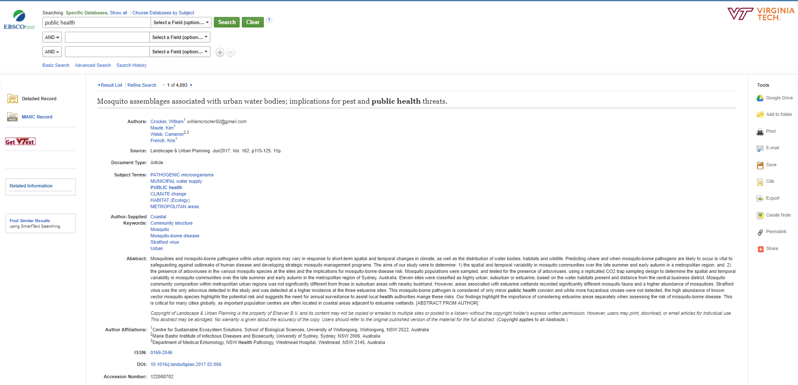
Tools to manage your search results
Click Get VText to link from this record to the article.
Standard tags link to all other articles about each of these topics across this database
Sample bib record from Urban Studies Abstracts

Slide 25
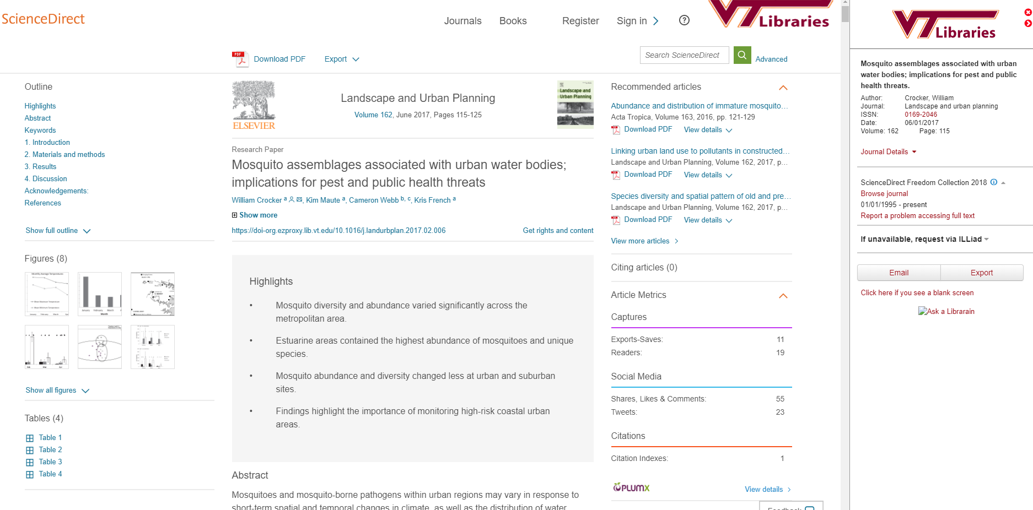
Article landing page in the journal, Landscape and Urban Planning

Slide 26
LIT SEARCH tactics
Apply the KISS principle
One at a time searching: one database, one search box, one search term (or “2-word phrase”)
Let the database sing to you
Experiment. Test your search terms and filters: how does each work?
If the results look wrong, it might be your fault -- not the database’s, not the literature’s
The more you have to typpe, the likelier you’l hit teh wrong key.
What do these common search terms have in common? TRUMP, DEPRESSION, LEAD
When you uncover another good-looking word or name (or subject heading) in your results, add it to your list, and search it
Good databases let you combine terms after you’ve seen how each works on its own
Sometime with only a checkbox and an AND button
Look for “search history” or “recent searches” options
In full-text databases, you usually must retype your terms. (Sigh.)

Slide 27
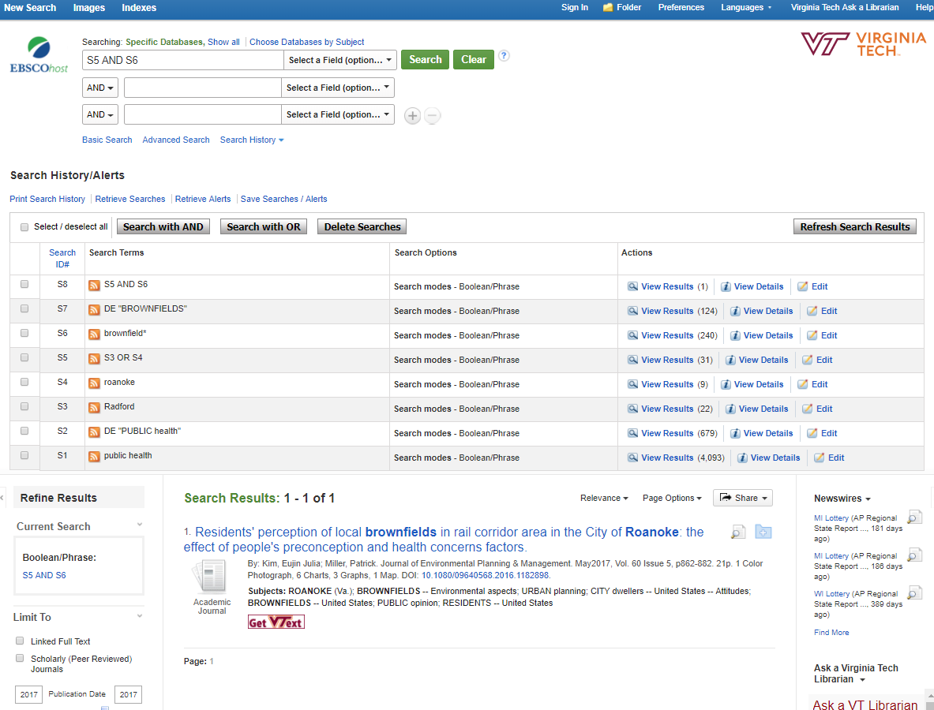
Speed dating: click-connect your simple searches. Experiment! See what comes up.
Focusing: from keyword to subject heading

